Slide 1
UVS Team 1

Slide 2
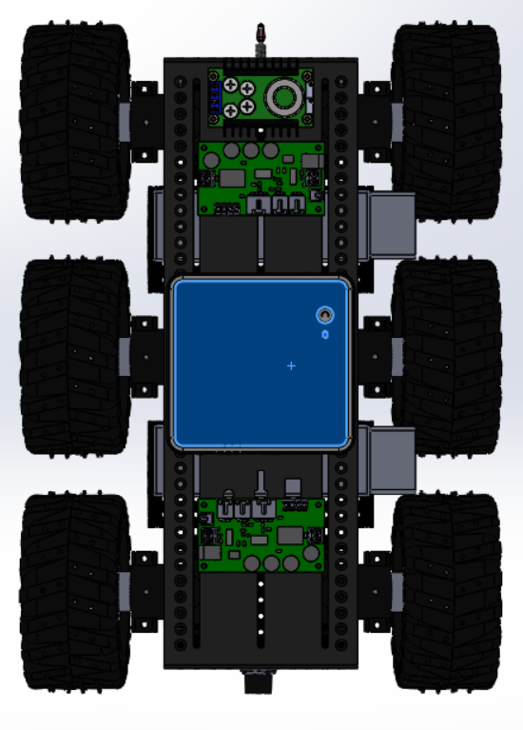
CAD ASSEMBLY

Slide 3
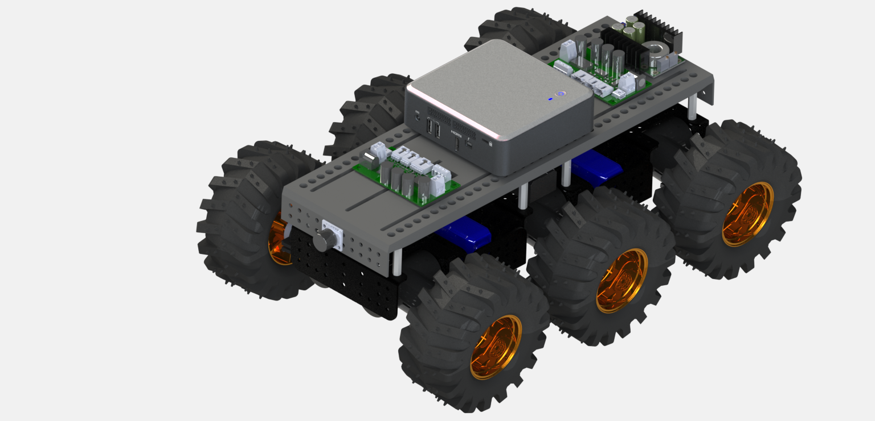
More cool renders of our rover

Slide 4
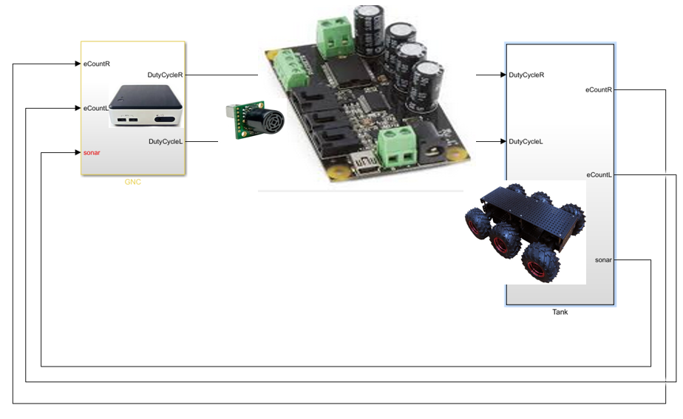
INTEGRATING SONAR SENSOR

Slide 5
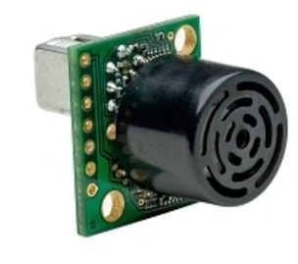
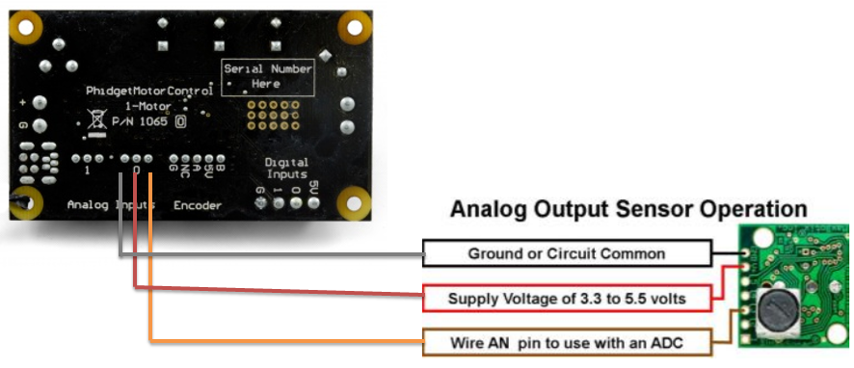
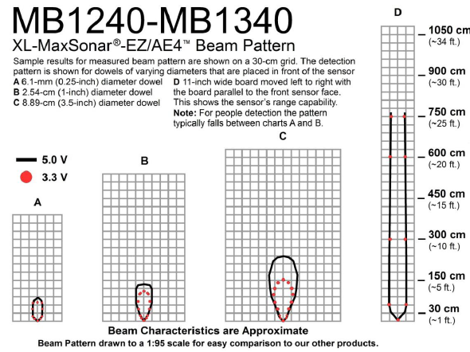
MB1240 XL-Max Sonar –EZ/E4
Power required - 3.3v-5.5v
Beam pattern represent 2D detection area of the sensor
but in reality its 3D cone shaped
Sensor Range - Not able to detect below 20 cm .
- detect up to to 750 cm.
Four patterns A, B, C, and D which represent the detection zone

Slide 6
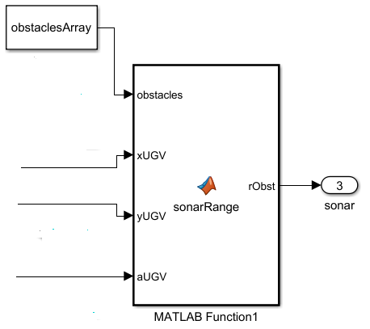
Working on Simulink Bench
Integration of Sonar
Matlab function1 –Inside Tank Block- incorporate sonar sensor
INPUT- orientation of the platform vehicle in XY frame
- positon in XY frame and radius for the multiple obstacle
OUTPUT- Range in outport number 3

Slide 7
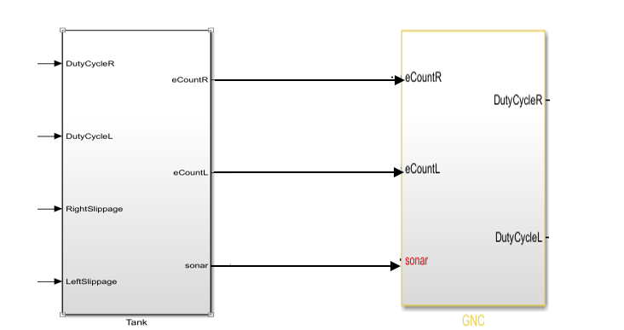
Working on Simulink Bench GNC
O/P from tank-(port number 3 , EtickL, EtickR)
I/P to GNC-(port number 3 , EtickL, EtickR)

Slide 8
How did we start programming it ?
Distance (cm) | Signal
10 | 21
15 | 21
20 | 21
25 | 30
30 | 35
40 | 54
50 | 79
Step 1: See output results with respect to distance to targets

Slide 9
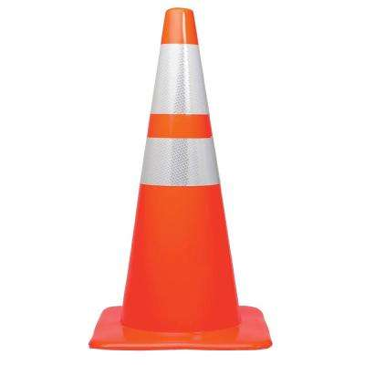
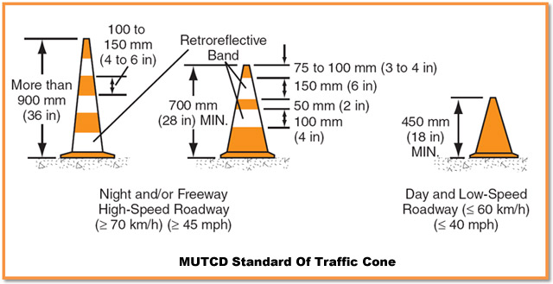
Step 2: Identify the obstacle Step 3: Establish a height of scan

Slide 10
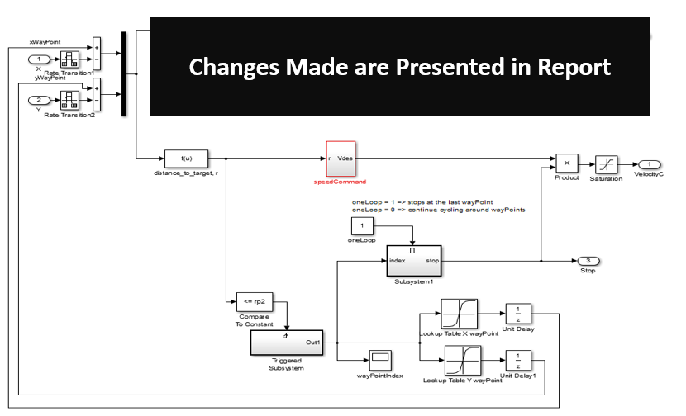
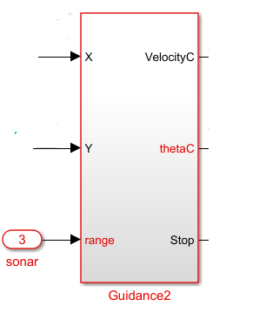
Working on Simulink Bench
I/P -sonar(port 3), x and y estimation (port3)
Use of Range information -able to avoid obstacle and way point navigation

Slide 11
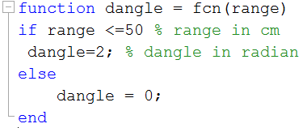
Code Implemented inside Guidance2

Slide 12
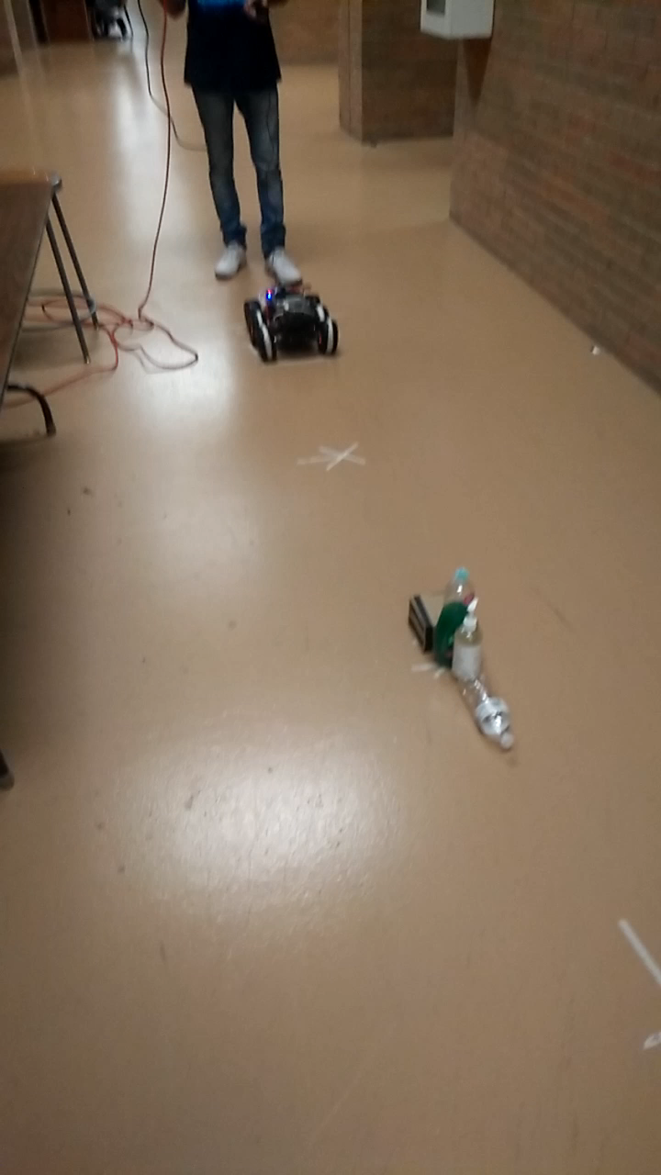
Testing

Slide 13
Thank YOU !
Thanks to Team 2 for lending us their sonar

